Slide 1
The Occultation of 7.3 magnitude hip 24973 by (3200) Phaethon
July 29, 2019
From Carrizo Plain, CA
Richard Nolthenius
Cabrillo College Astronomy

Slide 2
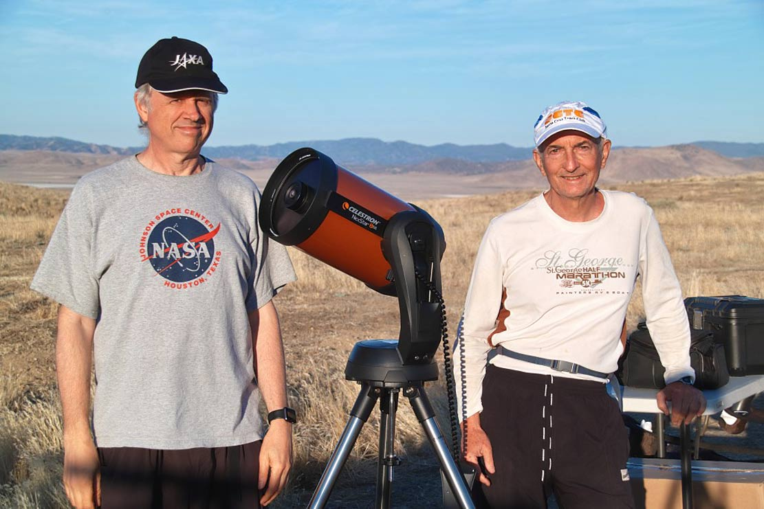
Kirk Bender (left) and Richard Nolthenius, at Bender’s station south of the shadow path

Slide 3
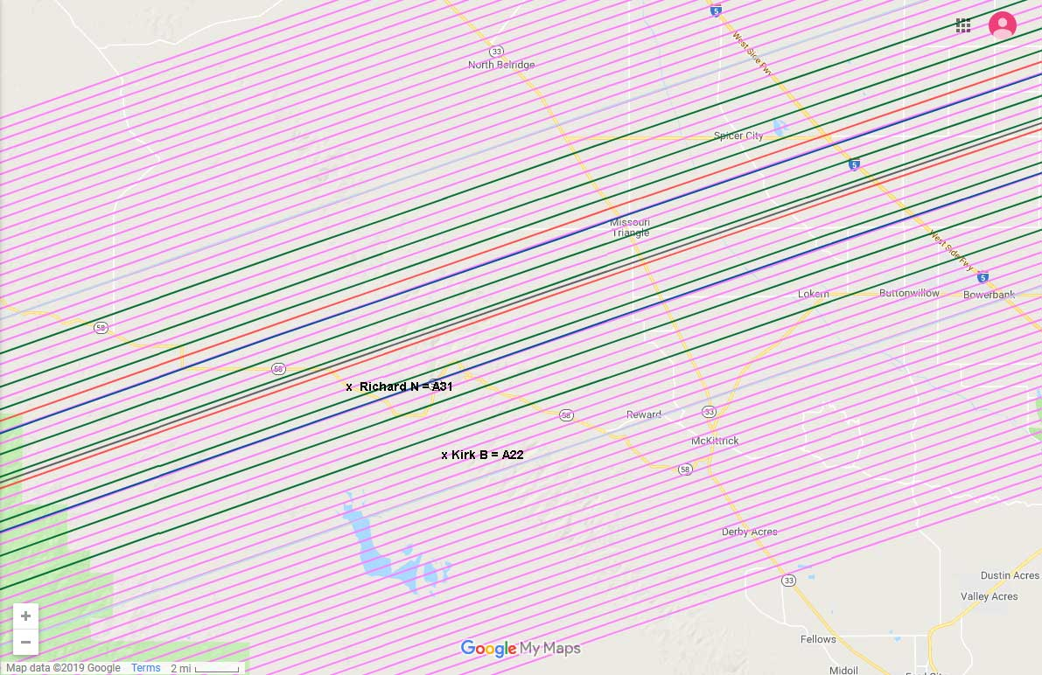
The bright target and importance encouraged a high turn-out of observers and Most tracks were manned. nolthenius and bender observed from carrizo plain, which was higher elevation and quieter than the central valley sites.

Slide 4
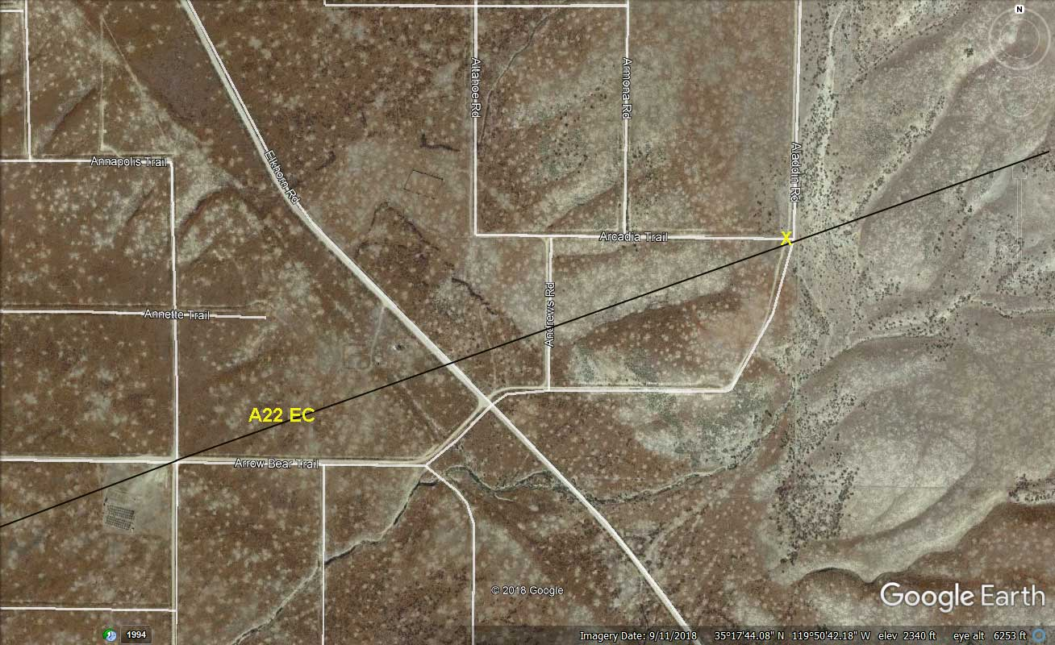
Bender was assigned track A22, which happened to cross a dirt road (“x”) intersection Nolthenius had used for a 22-event graze some 20 years earlier. It was our staging area and camp

Slide 5
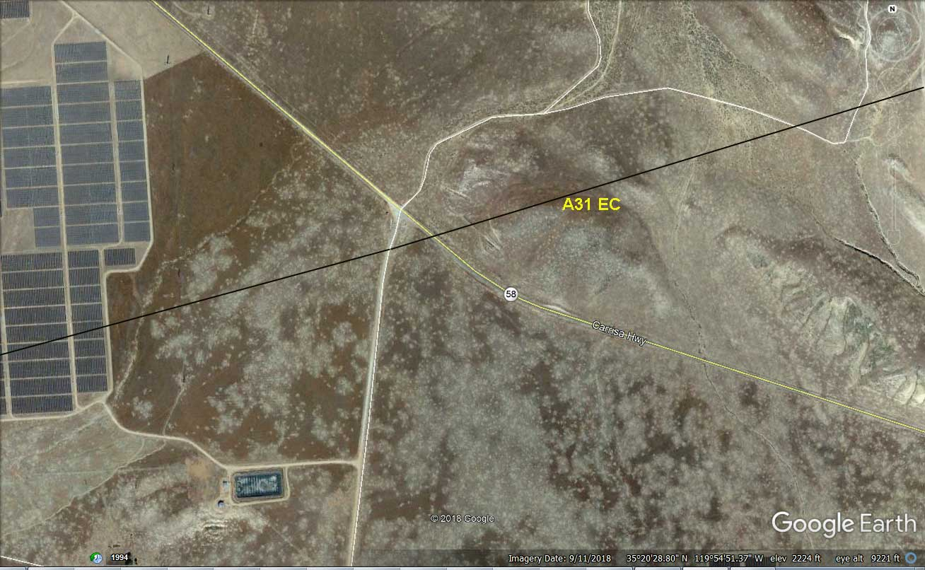
Nolthenius used track a31 in the center of the nominal predicted path. Set up was at an entrance to the topaz solar farm, one of the world’s largest.

Slide 6
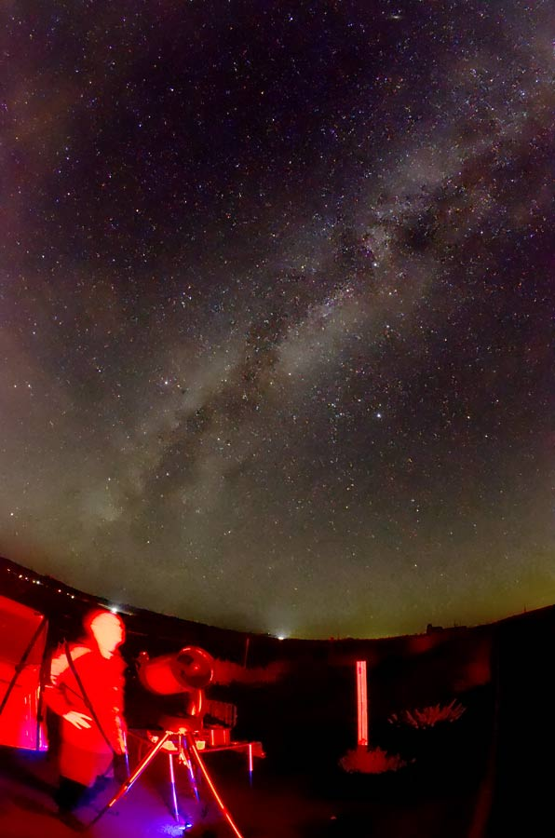
Both stations used identical equipment from cabrillo College Astronomy:
* Celestron 8SE SCT telescopes, powered by Orion dynamo Power stations.
* Meade f/3.3 focal reducers,
* iota-vti time inserters and
* watec 910hx video cameras powered by Duracell 14ah 12Vdc gel Cells.
* canon zr45mc camcorders to mini-DV using large capacity canon batteries.

Slide 7
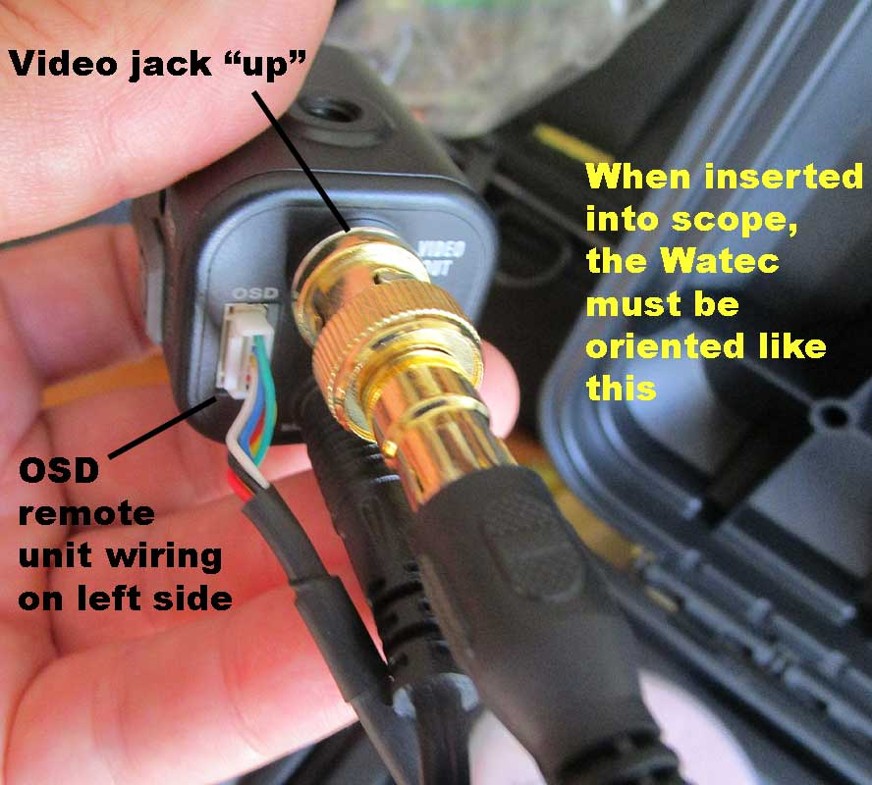
By careful orientation of the videocam on the 8se alt/az scope, and creation of custom Alt/Az finder charts in c2a, the scale and orientation of the star fields matches that seen in the orion q70 32mm eyepiece, and then on the Lcd screen of the canon camcorder.

Slide 8
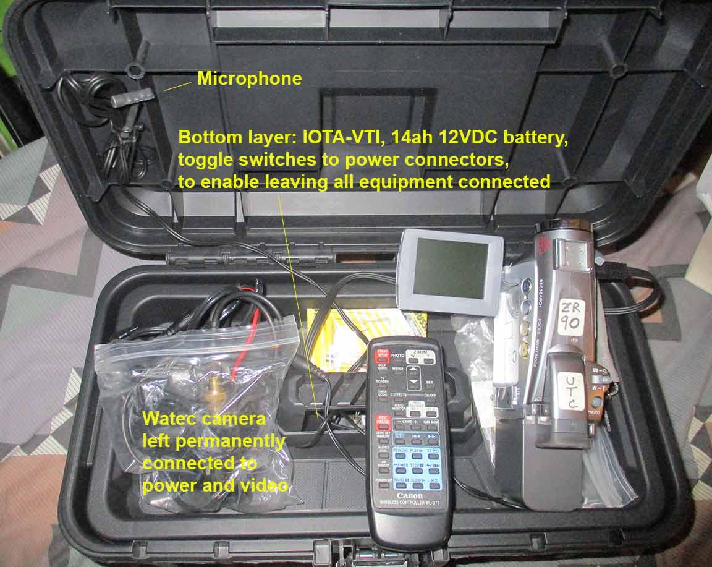
My custom designed “occ box”. during use, camcorder sits on top bay. wiring goes below to a 14ah battery and IOTA VTI. All equipment is left connected so deployment is fast. Power-up is with a single toggle switch

Slide 9
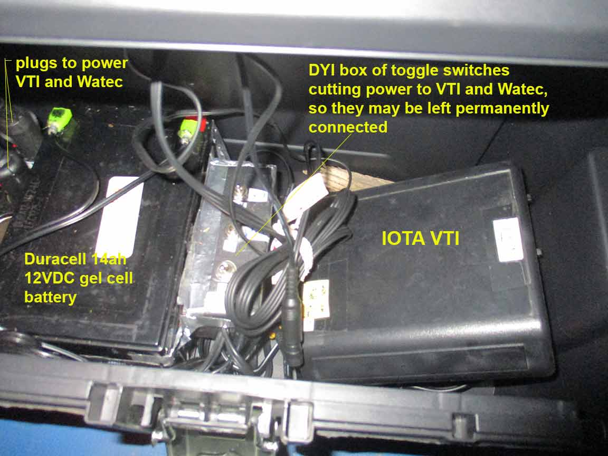
Under the top tray, the iota VTI and electrical connections are left permanently connected, with a toggle switch (accessible through a hole in the top tray) upstream of the plugs

Slide 10
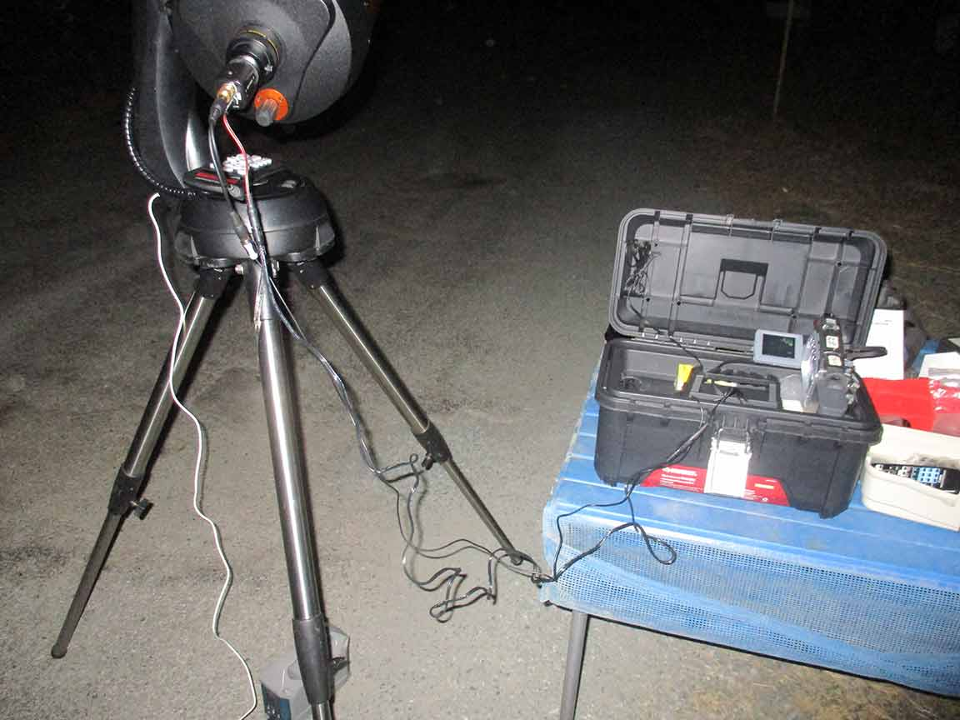
20 min before the event, I flip the power toggle so the VTI can sync w/ satellites. After scope is aimed, the Watec with power and video RCA cable attached are un-bagged, mounted, the video/audio cable from the VTI inserted in the canon camcorder, and we’re ready to record. Scope is powered with an Orion Dynamo lithium ion battery

Slide 11
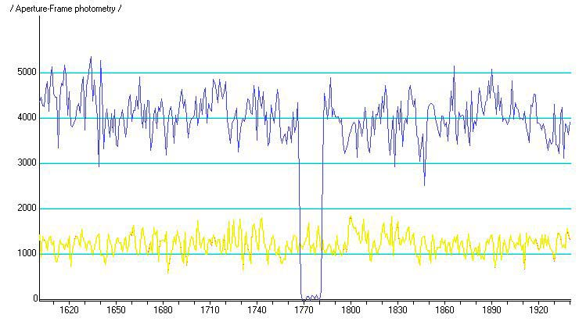
Limovie photometry from Nolthenius’ video

Slide 12
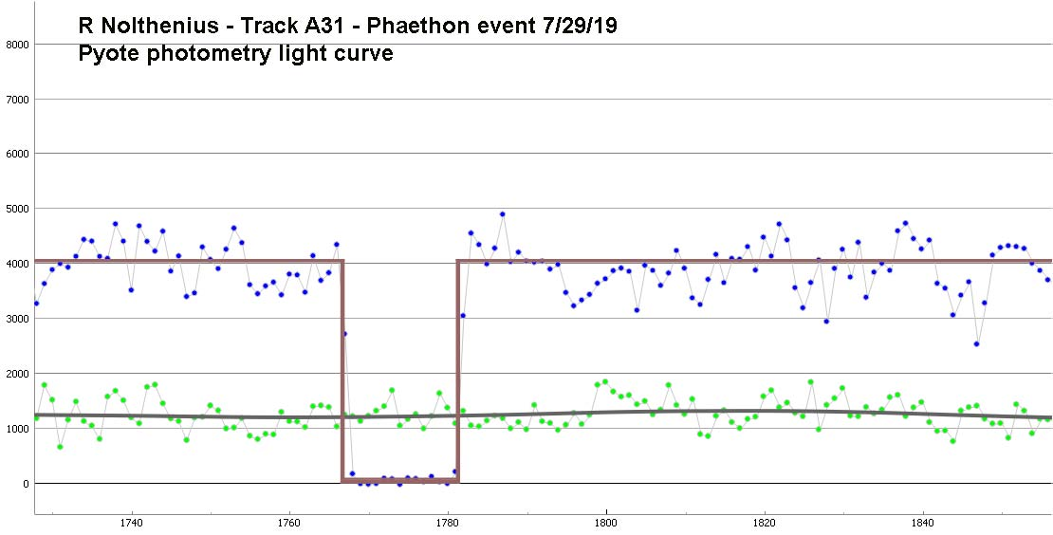
Timings determined by pyote software

Slide 13
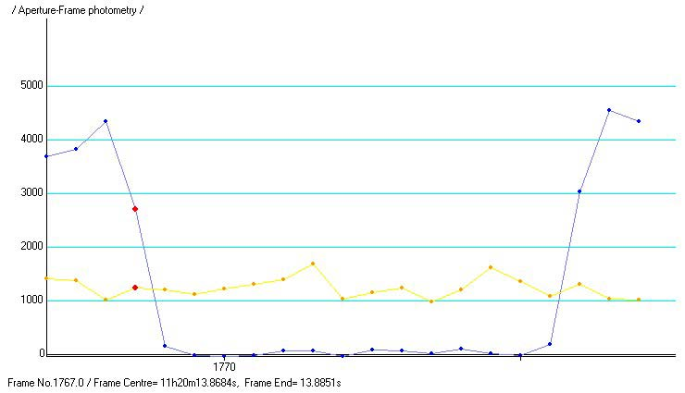
Duration of the event was only 0.4868 seconds

Slide 14
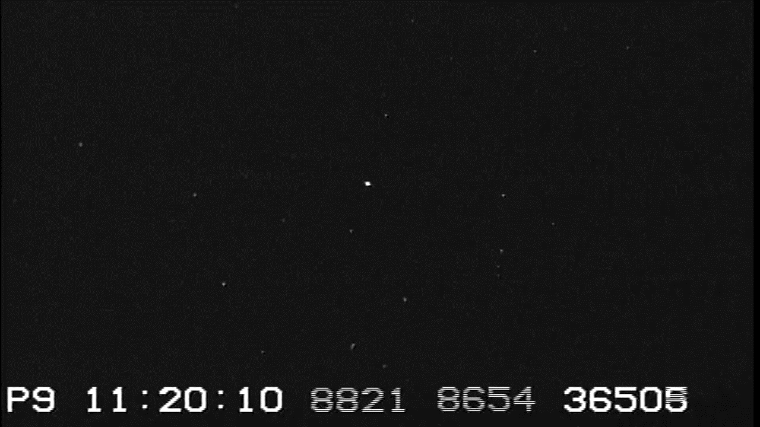
Nolthenius’ recording, trimmed to the event and comments made immediately after the event. Compressed to mp4 in VLC software.
.avi file captured from mini-DV by firewire and native Windows software

Slide 15
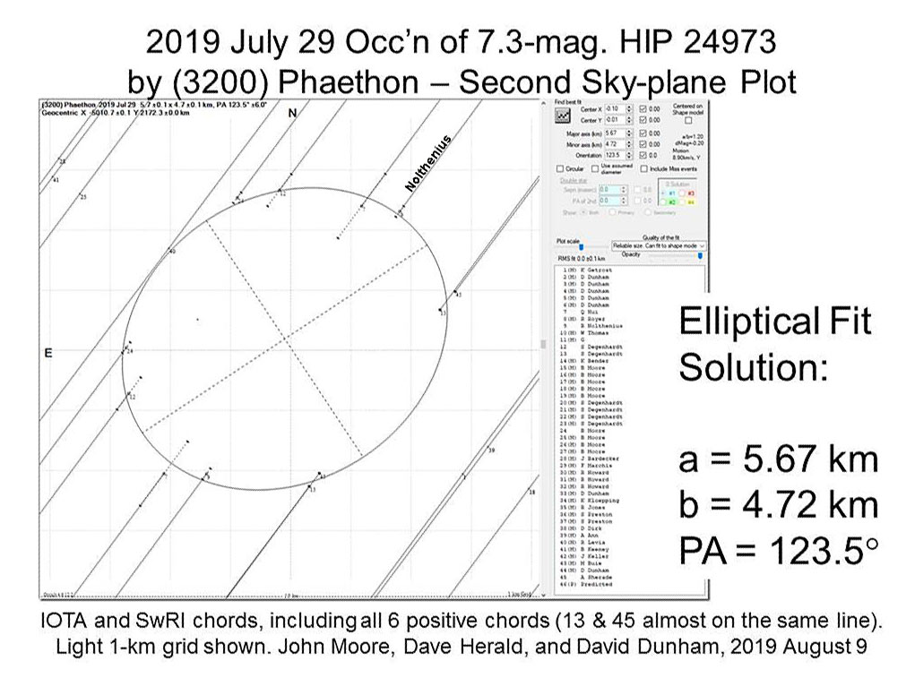
Sky plane plot of observations provided a good match to the radar image from 18 months earlier…

Slide 16
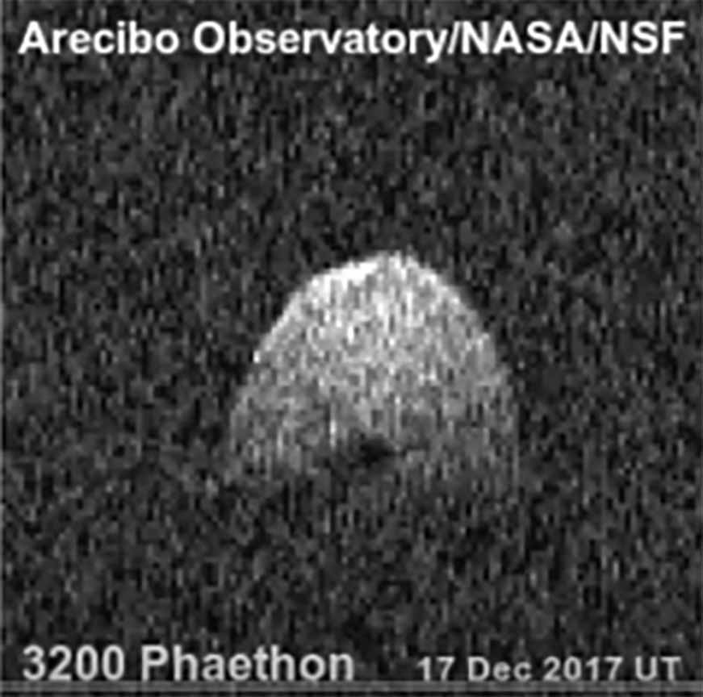
Arecibo radar imaging from December 2017. A fairly smooth, egg-shaped object

Slide 17
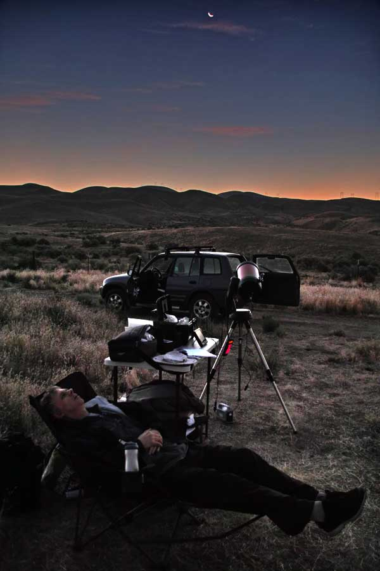
Kirk Bender recorded a miss.
Post-occultation rest before sunrise and hot temperatures returned.

