Slide 1
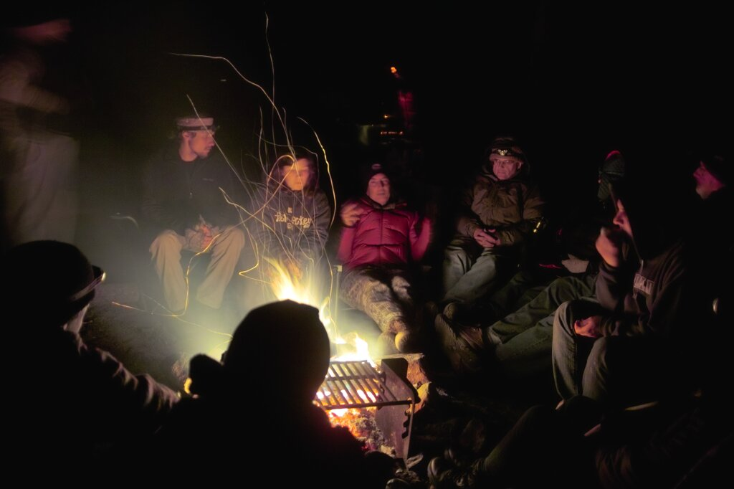
Astro 25 “Field Astronomy in the California Mountains”
July 13-15, 2018
At Chimney Peak Wilderness

Slide 2
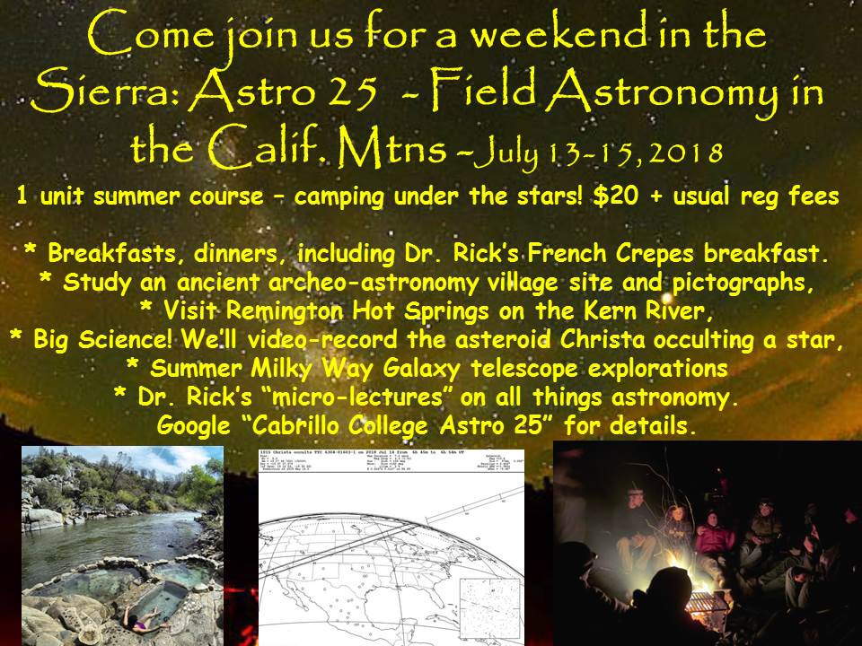

Slide 3
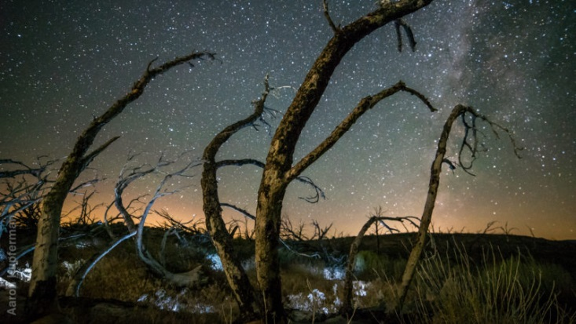
Milky Way above the sage

Slide 4
Campfire cosmology lecture! Especially if cloudy one or both nights (not likely!)

Slide 5
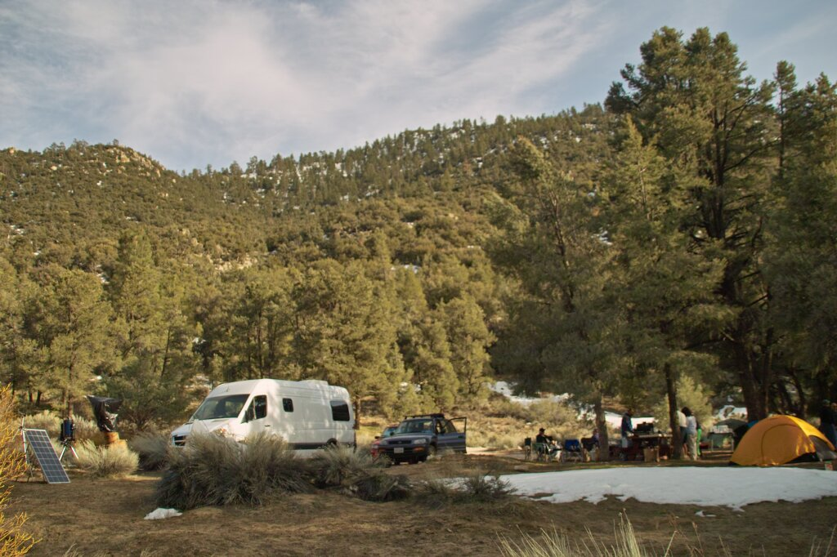
Astro 28M, in 2010, was conducted here

Slide 6
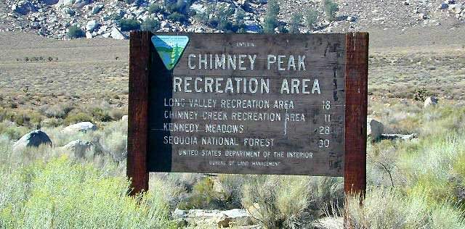
This sign is at the Hwy 178 / Canebrake Rd turnoff.

Slide 7
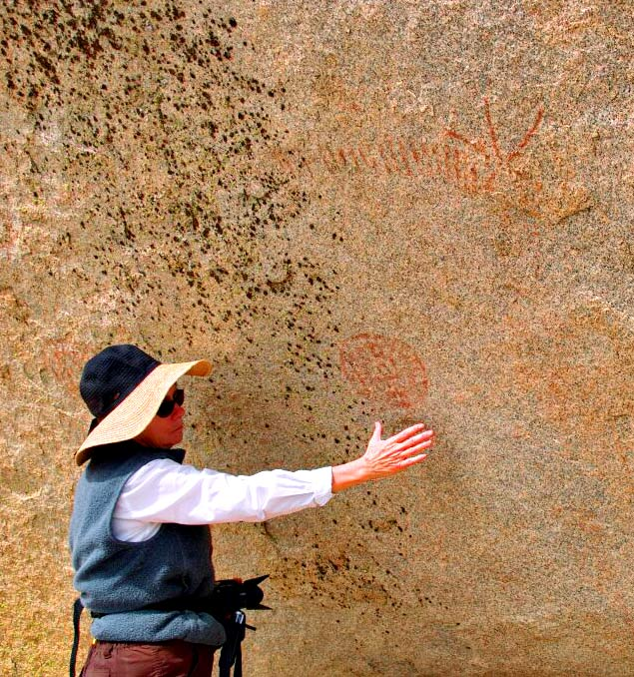
Anne, one of our volunteer helpers, in 2010, measuring some of the pictographs

Slide 8
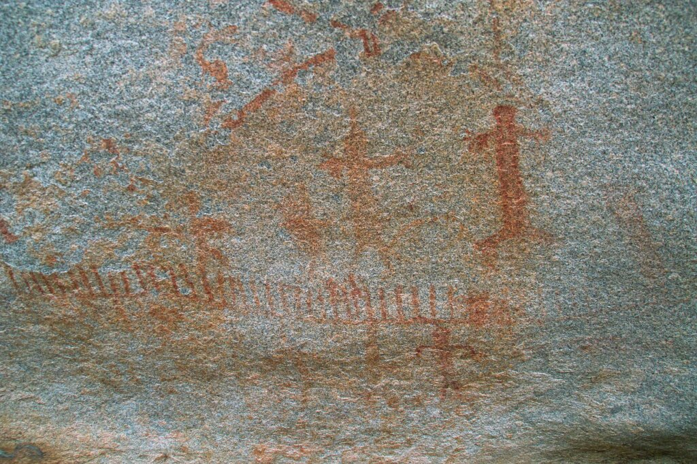

Slide 9
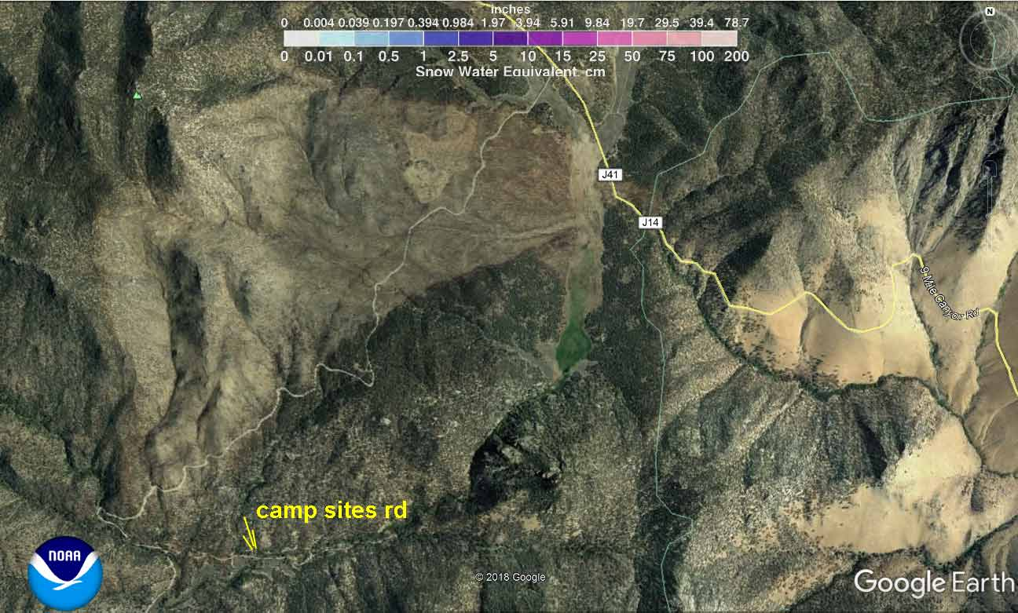
If you miss the campground turn, and keep going, you’ll end up “T”’ing into Kennedy Meadows Rd

Slide 10
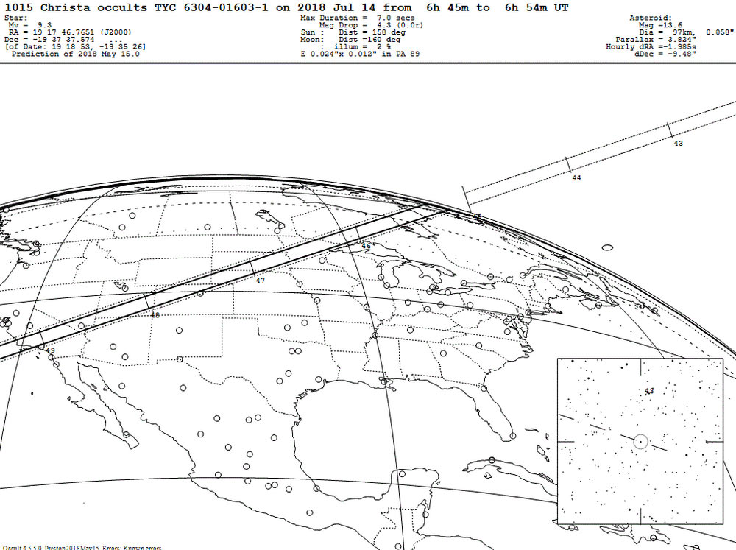
Site choice was determined by this rare and very favorable special event. A bright star (magnitude 9.3) will disappear behind the asteroid Christa along this path.

Slide 11
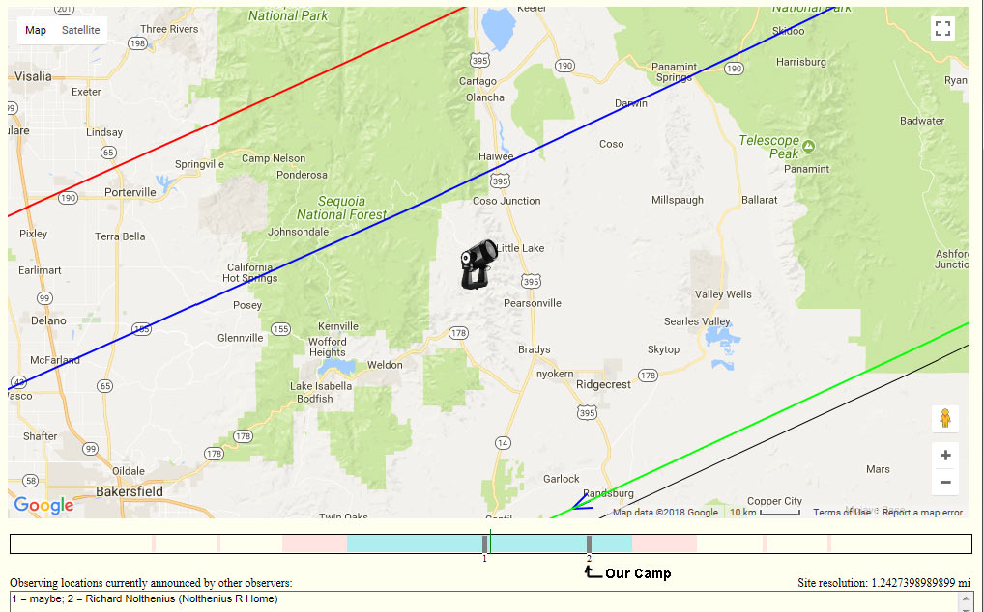
The northern limit of the path is not far north of camp. The red line is bounds the 1-standard deviation uncertainty northern limit

Slide 12
Our Big Science equipment!
8” Celestron 8SE telescope
Meade f/3.3 focal reducer to concentrate the focused light on…
Watec 910hx low light video camera
Signal to be combined with GPS time stamps using an IOTA Video Time Inserter, and the video frames then recorded on mini-DV tape with a Canon ZR45mc video recorder
Here’s what such an event looks like…

Slide 13
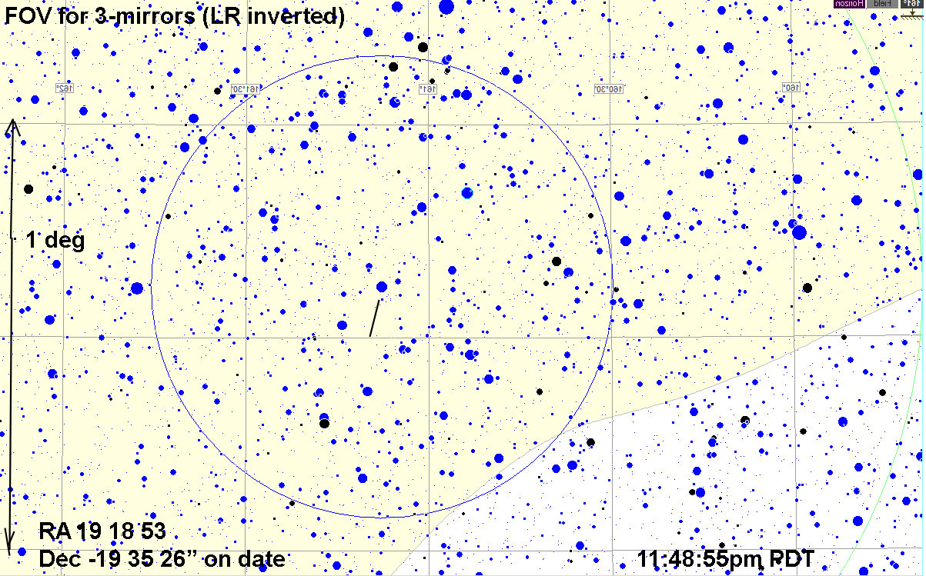
Target star, in rich star field of the Milky Way

Slide 14
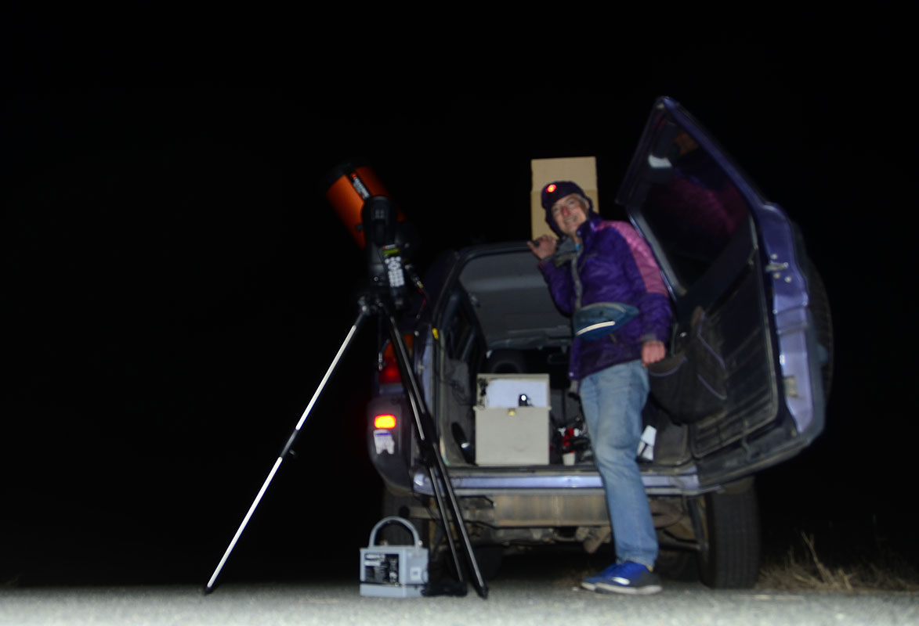
Scope, videocam, and VTI plus recording gear in the gray box

Slide 15
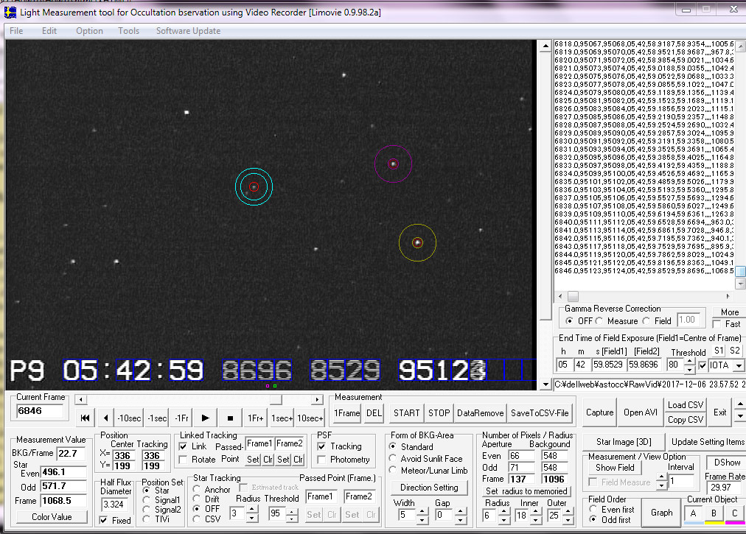
Software (LiMovie) will do photometry on the miniDV file.avi

Slide 16
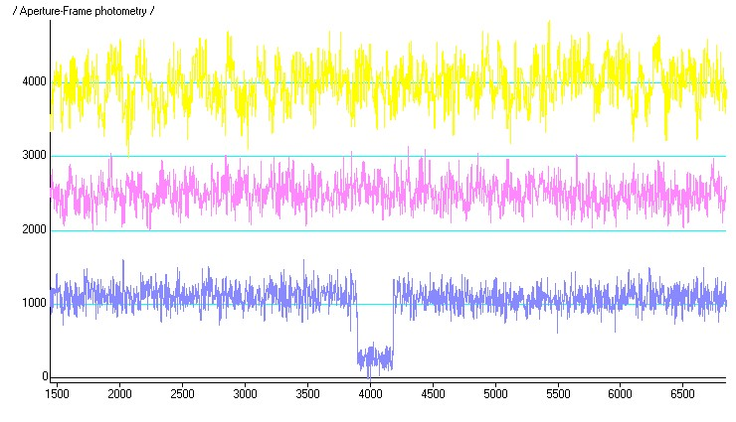
2 minutes of video photometry; lightcurves! Tracking star (yellow), comparison star (pink), and target star at bottom (blue). Note the few seconds of the occultation

Slide 17
Here’s a Couple of YouTube videos of an asteroid occultation
Occultation by Chariklo, and its ring! Watch close to see the brief drop due to the ring.
Kolga Occultation 2/5/2010; path, predictions, video, and resulting light curve

Slide 18
Combining Occultation timings from different observers across the path allows the precise outline of the asteroid to be measured more accurately than any other way, except by visiting spacecraft
May 14, 2018 Occultation by asteroid Virginia
If there is also long term photometry processed by computer models, then a combination of the shape and varying surface reflectivity can be determined. BUT – to separate these two different properties (shape, and how reflectivity changes across surface), then must have asteroid occultation data
May 1 2018 Occultation by Elektra

Slide 19
Our Event involves a bright star – magnitude 9.3, by the asteroid Christa
The event is at 11:49pm on Friday, as we’re wrapping up other observing.
From 10:45pm on, I and Kirk Bender and JP (our telescope team) will be showing you the whole process, from setting up, aligning the scope, identifying the target field, testing the equipment, and getting the data

Slide 20
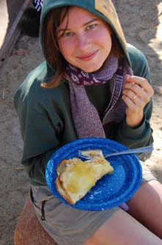
Saturday: I’ll get up early and start working on the French Crepes breakfast! Helpers can later carve fruit and set out the plates etc while I work my magic on the batter and stove.

Slide 21
Saturday Adventures
The Native American site will probably be our first goal
Then finding good spots along the Kern River for lectures and frolic’ing in the river. South Creek falls? Slide rocks? I’m still working on these.
I’d like to do a short hike to get to a look out over the desert, that will be closer to our camp. Will select a trail before I see you out there. There is fascinating geology and planetary processes here at the border between the Basin and Range and the Sierra.

Slide 22
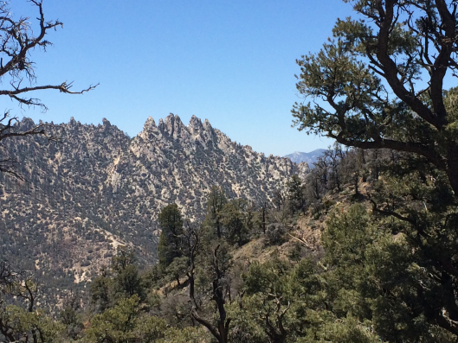
Rugged landscapes of pinyon pine. The Pacific Crest Trail runs through here

Slide 23
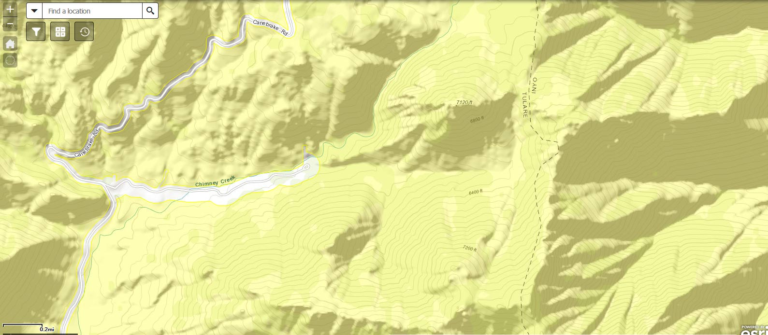
Topo map of our camp area. There should be a trail that can take us 1200 ft up to the ridge from the campground, and get a panoramic view of the desert.

Slide 24
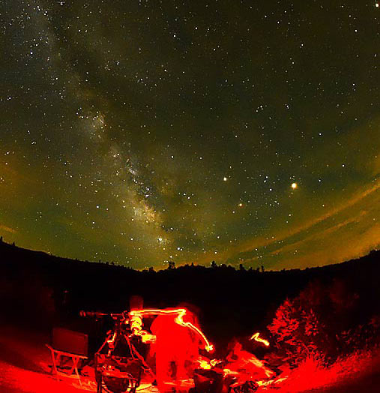
We’ll have 2 or 3 telescopes to show you the deep sky wonders along the star formation regions of the center areas of our Galaxy. Mars, Jupiter, and Saturn are all well placed too

Slide 25
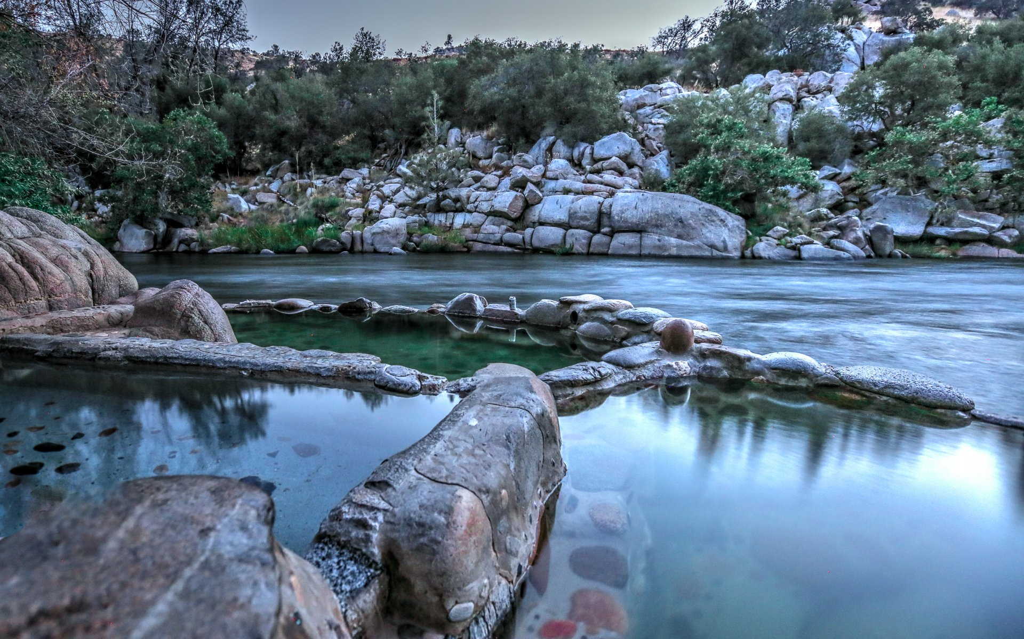
Sunday: Visit Remington Hot Springs on the Kern River below Lake Isabella

Slide 26
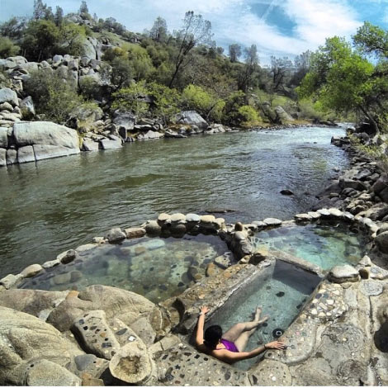
An intrepid group of volunteers contructed these pools right on the Kern River, from natural hot springs.
Afterwards – I’ll pass out the finals and we’ll say our bon voyage. You should be back in Santa Cruz well before dark.

Slide 27
Your responsibilities:
Read the “campers checklist” linked on our webpage and be sure you bring tent, and other camping gear
Bring water for your drinking. There is not likely to be water at the campsite.
Get yourself to/from the venues. The Cabrillo van will be jammed solid with cooking gear, telescopes, camp gear for instructor and volunteer(s)
Grading: based mostly on the take-home final exam. Also includes your participation in all activities. I’ll be taking roll at each “micro-lecture”.
You might consider taking a “NP” if you don’t care about your grade, since then you can sign up for another Astro 25 later, and have THAT one be for the grade!

